Slide 1
Author: Horstmann Title: Big Java Late Objects
“This material is reproduced with permission of John Wiley & Sons, Inc.”).

Slide 2

4
CHAPTER
LOOPS
Slides by Donald W. Smith
TechNeTrain.com
Final Draft
Oct 30, 2011

Slide 3
Chapter Goals
To implement while, for, and do loops
To hand-trace the execution of a program
To become familiar with common loop algorithms
To understand nested loops
To implement programs that read and process data sets
To use a computer for simulations
In this chapter, you will learn about loop statements in Java, as well as techniques for writing programs that simulate activities in the real world.

Slide 4
Contents
The while loop
Problem Solving: Hand-Tracing
The for loop
The do loop
Application: Processing Sentinels
Problem Solving: Storyboards
Common Loop Algorithms
Nested Loops
Application: Random Numbers and Simulations

Slide 5
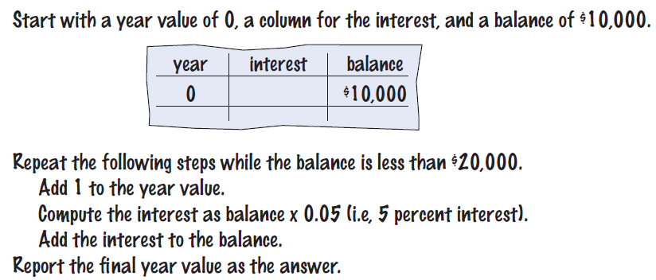

4.1 The while Loop
Examples of loop applications
Calculating compound interest
Simulations, event driven programs…
Compound interest algorithm (Chapter 1)
Steps

Slide 6
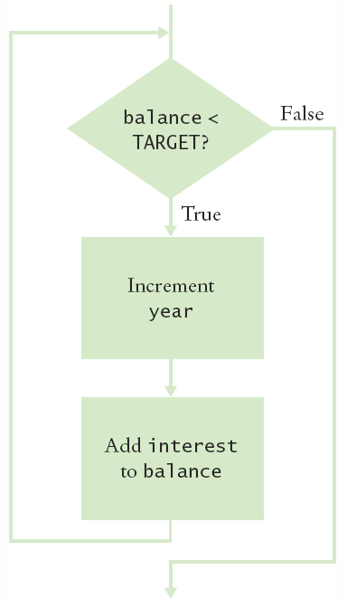
Planning the while Loop
A loop executes instructions
repeatedly while a condition is true.
while (balance < TARGET)
{
year++;
double interest = balance * RATE/100;
balance = balance + interest;
}

Slide 7
Syntax 4.1: while Statement

Slide 8
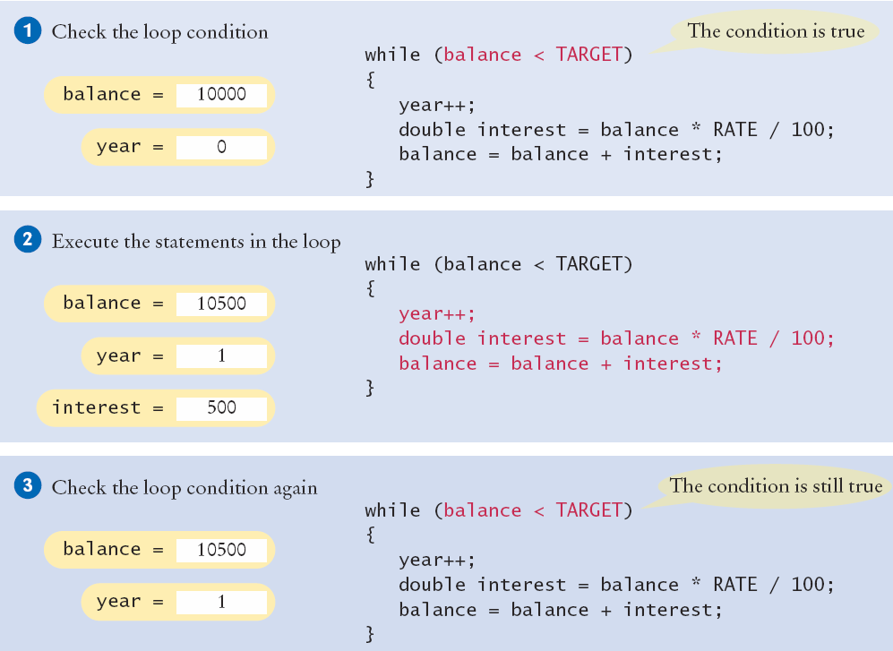
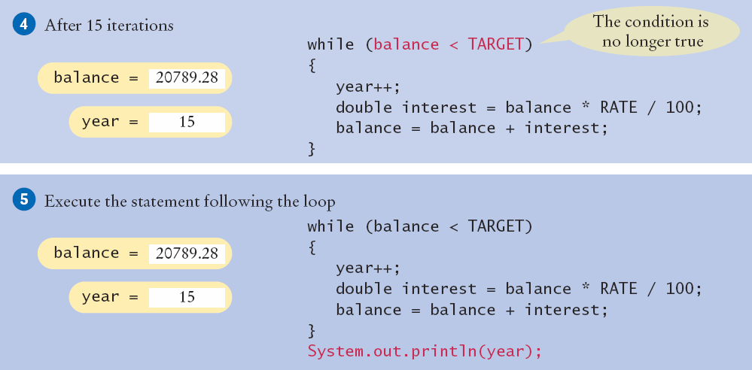
Execution of the Loop

Slide 9
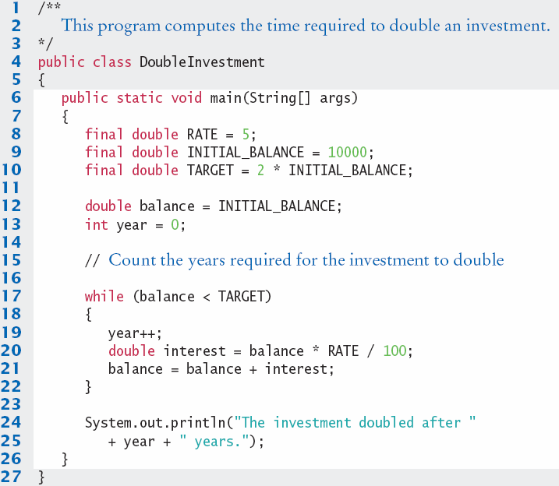
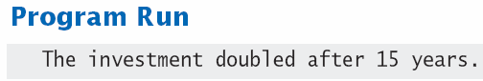
DoubleInvestment.java
Declare and initialize a variable outside of the loop to count years
Increment the years variable each time through

Slide 10

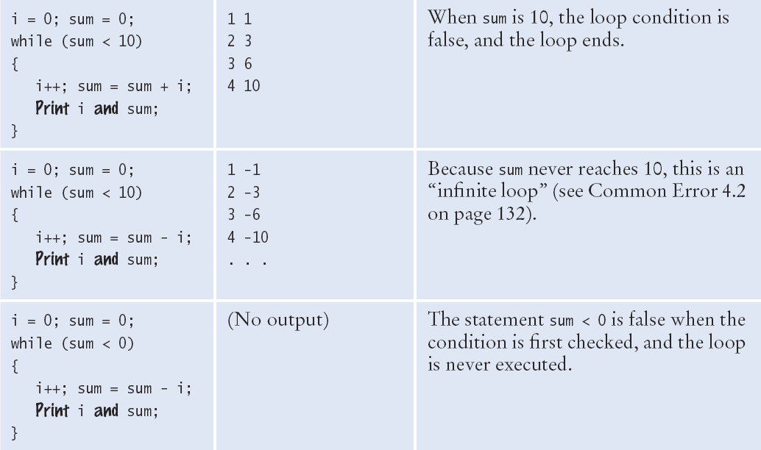
while Loop Examples (1)

Slide 11
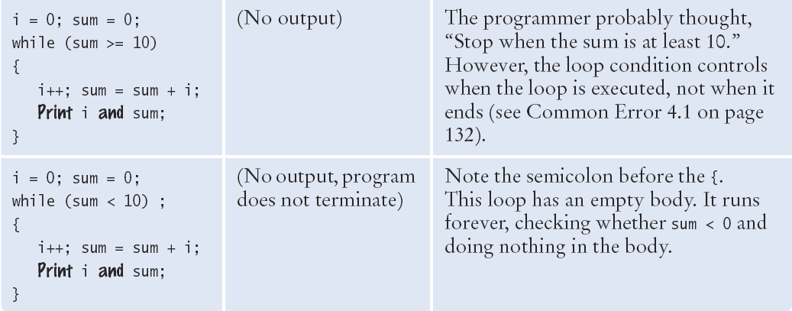
while Loop Examples (2)

Slide 12

Common Error 4.1
Don’t think “Are we there yet?”
The loop body will only execute if the test condition is True.
“Are we there yet?” should continue if False
If bal should grow until it reaches TARGET
Which version will execute the loop body?
while (bal < TARGET)
{
year++;
interest = bal * RATE;
bal = bal + interest;
}
while (bal >= TARGET)
{
year++;
interest = bal * RATE;
bal = bal + interest;
}

Slide 13
Common Error 4.2
Infinite Loops
The loop body will execute until the test condition becomes False.
What if you forget to update the test variable?
bal is the test variable (TARGET doesn’t change)
You will loop forever! (or until you stop the program)
while (bal < TARGET)
{
year++;
interest = bal * RATE;
}
bal = bal + interest;
}

Slide 14
Common Error 4.3
Off-by-One Errors
A ‘counter’ variable is often used in the test condition
Your counter can start at 0 or 1, but programmers often start a counter at 0
If I want to paint all 5 fingers, when I am done?
Start at 0, use < Start at 1, use <=
0, 1, 2, 3, 4 1, 2, 3, 4, 5
int finger = 0;
final int FINGERS = 5;
while (finger < FINGERS)
{
// paint finger
finger++;
}
int finger = 1;
final int FINGERS = 5;
while (finger <= FINGERS)
{
// paint finger
finger++;
}

Slide 15
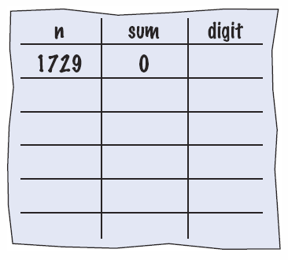
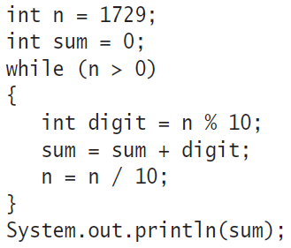

4.2: Hand-Tracing
Example: Calculate the sum of digits (1+7+2+9)
Make columns for key variables (n, sum, digit)
Examine the code and number the steps
Set variables to state before loop begins

Slide 16
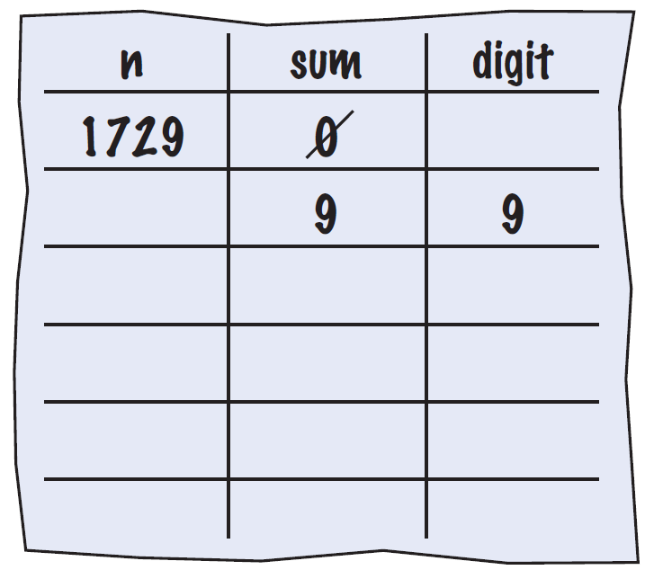
Tracing Sum of Digits
Start executing loop body statements changing variable values on a new line
Cross out values in previous line

Slide 17
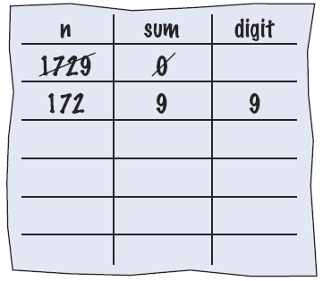
Tracing Sum of Digits
Continue executing loop statements changing variables
1729 / 10 leaves 172 (no remainder)

Slide 18
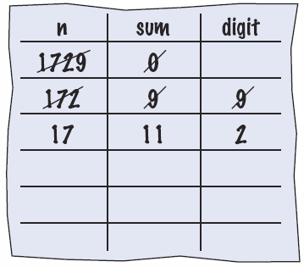
Tracing Sum of Digits
Test condition. If true, execute loop again
Variable n is 172, Is 172 > 0?, True!
Make a new line for the second time through and update variables

Slide 19
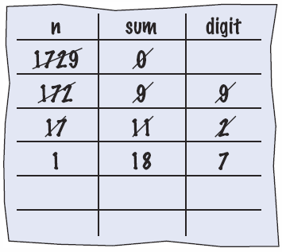
Tracing Sum of Digits
Third time through
Variable n is 17 which is still greater than 0
Execute loop statements and update variables

Slide 20
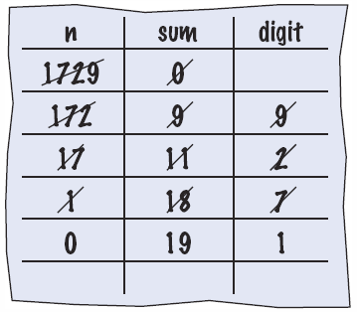
Tracing Sum of Digits
Fourth loop iteration:
Variable n is 1 at start of loop. 1 > 0? True
Executes loop and changes variable n to 0 (1/10 = 0)

Slide 21
Tracing Sum of Digits
Because n is 0, the expression(n > 0) is False
Loop body is not executed
Jumps to next statement after the loop body
Finally prints the sum!

Slide 22
Summary of the while Loop
while loops are very commonly used
Initialize variables before you test
The condition is tested BEFORE the loop body
This is called pre-test
The condition often uses a counter variable
Something inside the loop should change one of the variables used in the test
Watch out for infinite loops!

Slide 23
4.3 The for Loop
Use a for loop when you:
Can use an integer counter variable
Have a constant increment (or decrement)
Have a fixed starting and ending value for the counter
int i = 5; // initialize
while (i <= 10) // test
{
sum = sum + 1;
i++; // update
}
Use a for loop when a value runs from a starting point to an
ending point with a constant increment or decrement.
while version
for (int i = 5; i <= 10; i++)
{
sum = sum + i;
}
for version

Slide 24
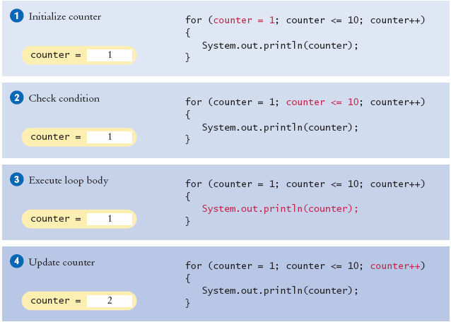

Execution of a for Loop
2
3
2
3
2
3

Slide 25
Syntax 4.2: for Statement
Two semicolons separate the three parts
Initialization ; Condition ; Update

Slide 26
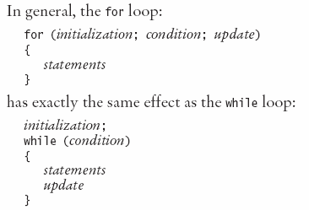
When to use a for Loop?
Yes, a while loop can do everything a for loop can do
Programmers like it because it is concise
Initialization
Condition
Update
All on one line!

Slide 27
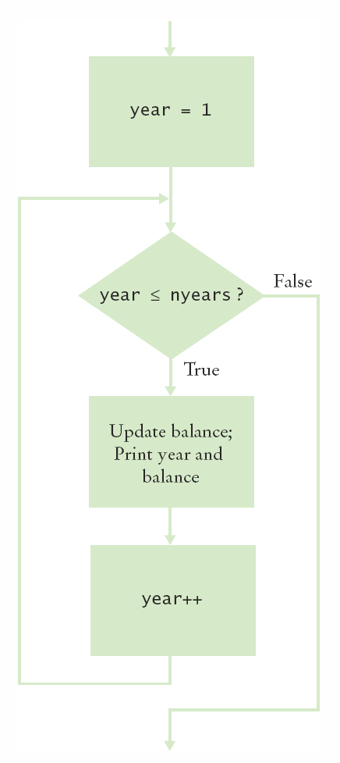
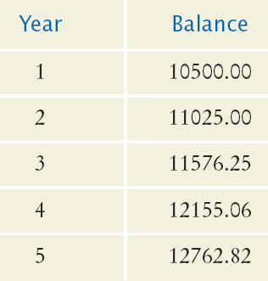
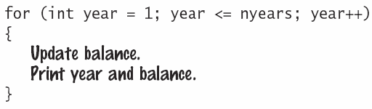
Planning a for Loop
Print the balance at the end of each year for a number of years

Slide 28
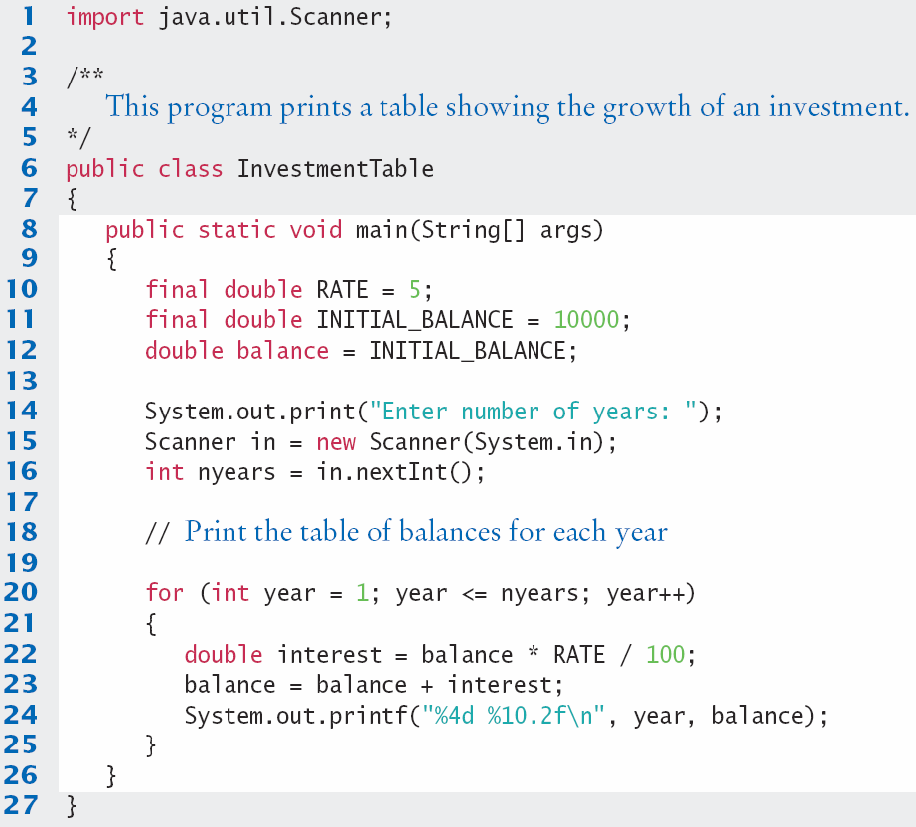
InvestmentTable.java
Setup variables
Get input
Loop
Calc
Output

Slide 29
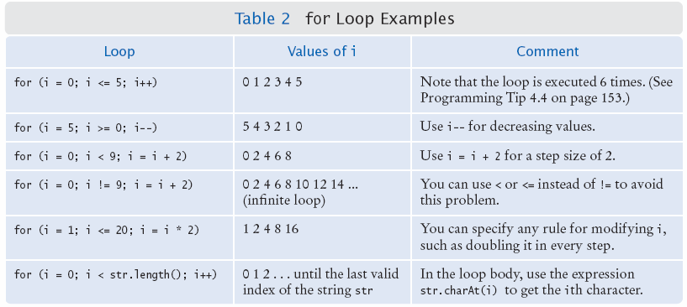
Good Examples of for Loops
Keep it simple!

Slide 30
for Loop variable Scope
for( int x = 1; x < 10; x = x + 1) {
// steps to do inside the loop
// You can use ‘x’ anywhere in this box
}
if (x > 100) // Error! x is out of scope!
Scope is the ‘lifetime’ of a variable.
When ‘x’ is declared in the for statement:
‘x’ exists only inside the ‘block’ of the for loop { }
Solution: Declare‘x’outside the for loop
int x;
for(x = 1; x < 10; x = x + 1)

Slide 31

Programming Tip 4.1
Use for loops for their intended purposes only
Increment (or decrement) by a constant value
Do not update the counter inside the body
Update in the third section of the header
Most counters start at one ‘end’ (0 or 1)
Many programmers use an integer named i for ‘index’ or ‘counter’ variable in for loops
for (int counter = 1; counter <= 100; counter++)
{
if (counter % 10 == 0) // Skip values divisible by 10
{
counter++; // Bad style: Do NOT update the counter inside loop
}
System.out.println(counter);
}

Slide 32

Programming Tip 4.3
Count Iterations
Many bugs are ‘off by one’ issues
One too many or one too few
How many posts are there?
How many pairs of rails are there?
Painting rail 1
Painting rail 2
Painting rail 3
Painting rail 4
final int RAILS = 5;
for (int i = 1; i < RAILS; i++ )
{
System.out.println("Painting rail " + i);
}

Slide 33
Summary of the for Loop
for loops are very commonly used
They have a very concise notation
Initialization ; Condition ; Update
Initialization happens once at the start
Condition is tested every time BEFORE executing the body (pre-test)
Increment is done at the end of the body
Great for integer counting, String (array) processing and more

Slide 34
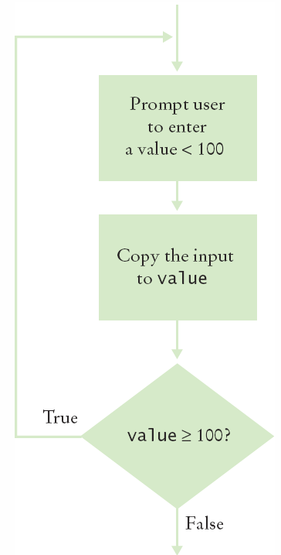
4.4 The do Loop
Use a do loop when you want to:
Execute the body at least once
Test the condition AFTER your first loop
int i = 1; // initialize
final int FINGERS = 5;
do
{
// paint finger
i++; // update
}
while (i <= FINGERS); // test
Note the semicolon at the end!

Slide 35
do Loop Example
User Input Validation:
Range check a value entered
User must enter something to validate first!
int value;
do
{
System.out.println(“Enter an integer < 100: ”);
value = in.nextInt();
}
while (value >= 100); // test

Slide 36
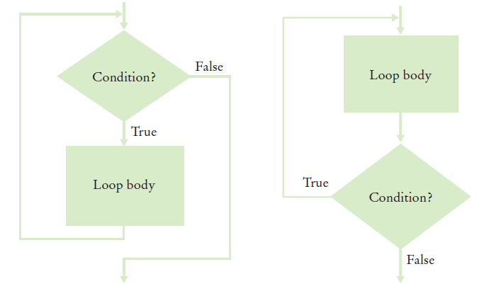
Programming Tip 4.4
Flowcharts for loops
To avoid ‘spaghetti code’, never have an arrow that points inside the loop body
while and for
test before
do tests
after

Slide 37

4.5 Processing Sentinel Values
Sentinel values are often used:
When you don’t know how many items are in a list, use a ‘special’ character or value to signal no more items.
For numeric input of positive numbers, it is common to use the value -1:
salary = in.nextDouble();
while (salary != -1)
{
sum = sum + salary;
count++;
salary = in.nextDouble();
}
A sentinel value denotes the end of a data set, but it is not part of the data.

Slide 38
Averaging a set of values
Declare and initialize a ‘sum’ variable to 0
Declare and initialize a ‘count’ variable to 0
Declare and initialize an ‘input’ variable to 0
Prompt user with instructions
Loop until sentinel value is entered
Save entered value to input variable
If input is not -1 (sentinel value)
Add input to sum variable
Add 1 to count variable
Make sure you have at least one entry before you divide!
Divide sum by count and output. Done!

Slide 39
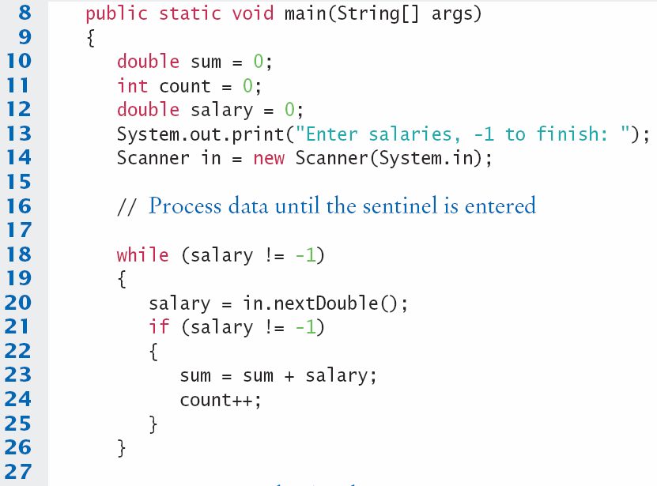
SentinelDemo.java (1)
Outside the while loop, declare and initialize variables to use
Since salary is initialized to 0, the while loop statements will be executed
Input new salary and compare to sentinel
Update running sum and count to average later

Slide 40
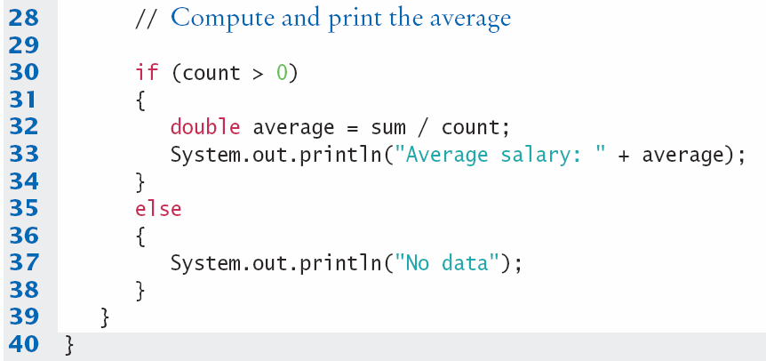
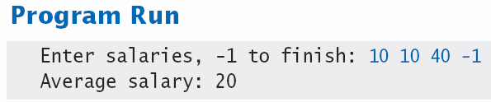
SentinelDemo.java (2)
Prevent divide by 0
Calculate and output the average salary using sum and count variables

Slide 41
Boolean variables and sentinels
A boolean variable can be used to control a loop
Sometimes called a ‘flag’ variable
System.out.print("Enter salaries, -1 to finish: ");
boolean done = false;
while (!done)
{
value = in.nextDouble();
if (value == -1)
{
done = true;
}
else
{
// Process value
}
}
Initialize done so that loop will execute
Set done ‘flag’ to true if sentinel value is found

Slide 42
To input any numeric value…
When valid values can be positive or negative
You cannot use -1 (or any other number) as a sentinel
One solution is to use a non-numeric sentinel
But Scanner’s in.nextDouble will fail!
Use Scanner’s in.hasNextDouble first
Returns a boolean: true (all’s well) or false (not a number)
Then use in.nextDouble if true
System.out.print("Enter values, Q to quit: ");
while (in.hasNextDouble())
{
value = in.nextDouble();
// Process value
}

Slide 43
4.6 Storyboards
One useful problem solving technique is the use of storyboards to model user interaction. It can help answer:
What information does the user provide, and in which order?
What information will your program display, and in which format?
What should happen when there is an error?
When does the program quit?
A storyboard consists of annotated sketches for each step in an action
sequence.

Slide 44
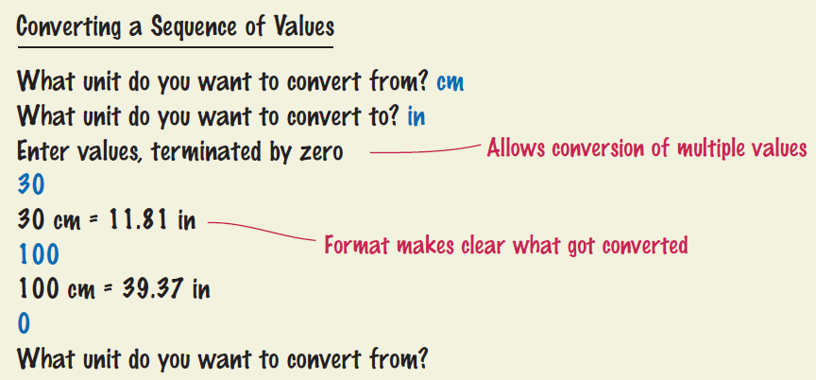
Storyboard Example
Goal: Converting a sequence of values
Will require a loop and some variables
Handle one conversion each time through the loop

Slide 45
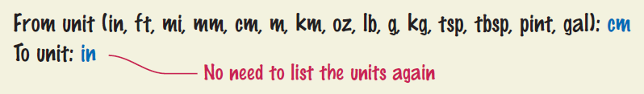
What can go wrong?
Unknown unit types
How do you spell centimeters and inches?
What other conversions are available?
Solution:
Show a list of the acceptable unit types

Slide 46
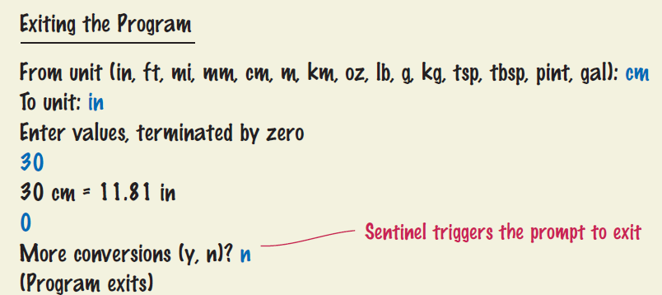
What else can go wrong?
How does the user quit the program?
Storyboards help you plan a program
Knowing the flow helps you structure your code

Slide 47
4.7 Common Loop Algorithms
1: Sum and Average Value
2: Counting Matches
3: Finding the First Match
4: Prompting until a match is found
5: Maximum and Minimum
6: Comparing Adjacent Values

Slide 48
Sum and Average Examples
double total = 0;
while (in.hasNextDouble())
{
double input = in.nextDouble();
total = total + input;
}
Sum of Values
Initialize total to 0
Use while loop with sentinel
double total = 0;
int count = 0;
while (in.hasNextDouble())
{
double input = in.nextDouble();
total = total + input;
count++;
}
double average = 0;
if (count > 0)
{ average = total / count; }
Average of Values
Use Sum of Values
Initialize count to 0
Increment per input
Check for count 0
Before divide!

Slide 49

Counting Matches
int upperCaseLetters = 0;
for (int i = 0; i < str.length(); i++)
{
char ch = str.charAt(i);
if (Character.isUpperCase(ch))
{
upperCaseLetters++;
}
}
Counting Matches
Initialize count to 0
Use a for loop
Add to count per match

Slide 50

Finding the First Match
boolean found = false;
char ch;
int position = 0;
while (!found &&
position < str.length())
{
ch = str.charAt(position);
if (Character.isLowerCase(ch))
{
found = true;
}
else { position++; }
}
Initialize boolean sentinel to false
Initialize position counter to 0
First char in String
Use a compound conditional in loop
A pre-test loop (while or for) will handle the case where the string is empty!

Slide 51
Prompt Until a Match is Found
boolean valid = false;
double input;
while (!valid)
{
System.out.print("Please enter a positive value < 100: ");
input = in.nextDouble();
if (0 < input && input < 100) { valid = true; }
else { System.out.println("Invalid input."); }
}
Initialize boolean flag to false
Test sentinel in while loop
Get input, and compare to range
If input is in range, change flag to true
Loop will stop executing

Slide 52
Maximum and Minimum
double largest = in.nextDouble();
while (in.hasNextDouble())
{
double input = in.nextDouble();
if (input > largest)
{
largest = input;
}
}
double smallest = in.nextDouble();
while (in.hasNextDouble())
{
double input = in.nextDouble();
if (input > smallest)
{
smallest = input;
}
}
Get first input value
This is the largest (or smallest) that you have seen so far!
Loop while you have a valid number (non-sentinel)
Get another input value
Compare new input to largest (or smallest)
Update largest (or smallest) if necessary

Slide 53

Comparing Adjacent Values
double input = in.nextDouble();
while (in.hasNextDouble())
{
double previous = input;
input = nextDouble();
if (input == previous)
{
System.out.println("Duplicate input");
}
}
Get first input value
Use while to determine if there are more to check
Copy input to previous variable
Get next value into input variable
Compare input to previous, and output if same

Slide 54
Steps to Writing a Loop
Planning:
Decide what work to do inside the loop
Specify the loop condition
Determine loop type
Setup variables before the first loop
Process results when the loop is finished
Trace the loop with typical examples
Coding:
Implement the loop in Java

Slide 55
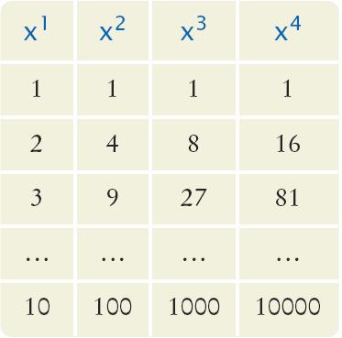
4.8 Nested Loops
How would you print a table with rows and columns?
Print top line (header)
Use a for loop
Print table body…
How many rows?
How many columns?
Loop per row
Loop per column

Slide 56
Flowchart of a Nested Loop
x = 1
x <= 10?
True
n= 1
Inner Loop
False
n <= 4?
True
Print x^n
False
n++
Print new line
x++
Done

Slide 57
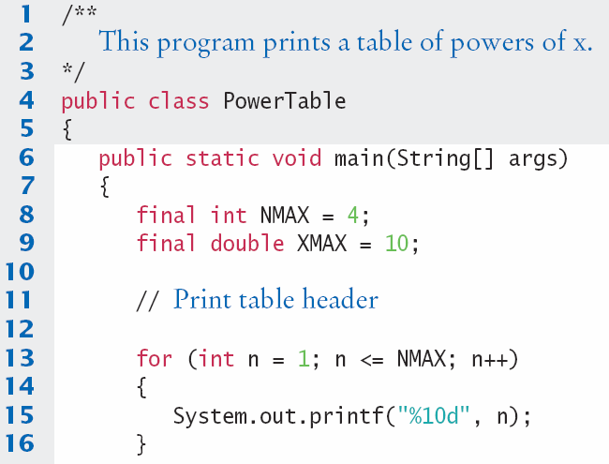
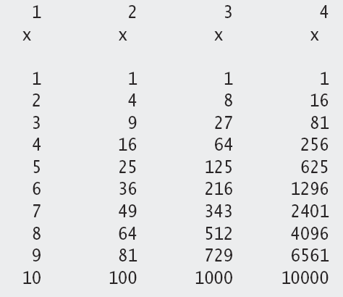
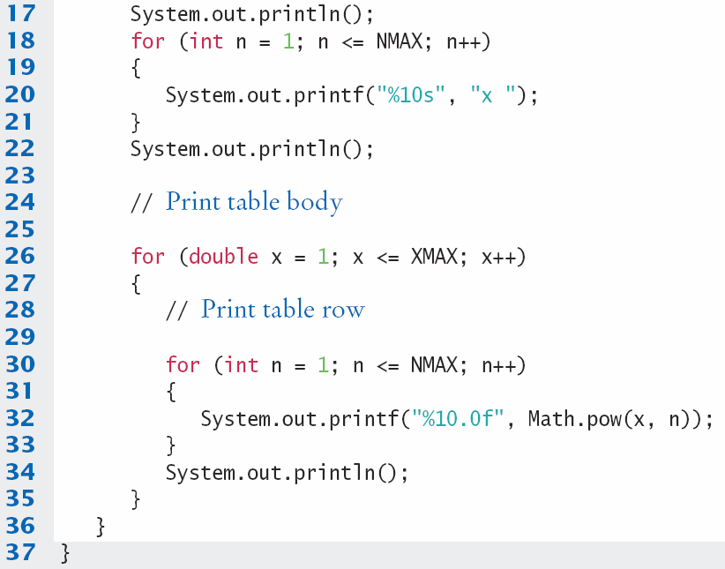
PowerTable.java
Body of outer loop
Body of inner loop

Slide 58
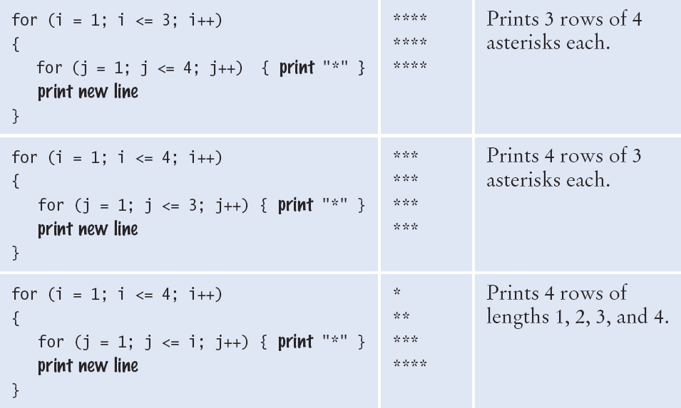
Nested Loop Examples (1)

Slide 59
Nested Loop Examples (2)

Slide 60
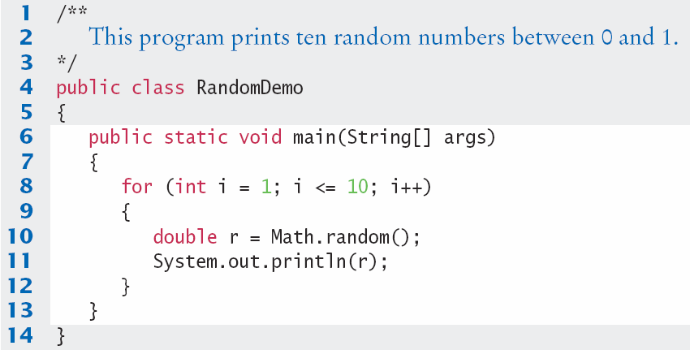
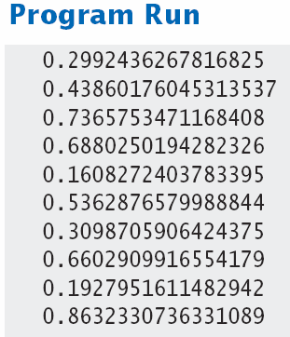
RandomDemo.java

Slide 61
4.9 Random Numbers/Simulations
Games often use random numbers to make things interesting
Rolling Dice
Spinning a wheel
Pick a card
A simulation usually involves looping through a sequence of events
Days
Events

Slide 62

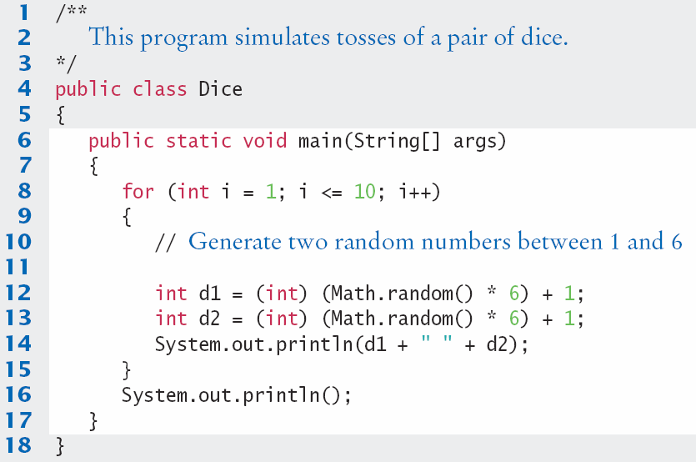
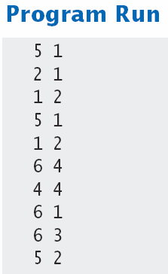
Simulating Die Tosses
Goal:
Get a random integer between 1 and 6

Slide 63
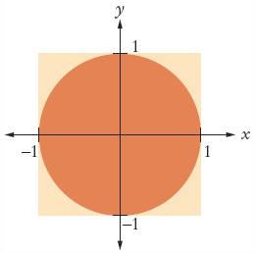
The Monte Carlo Method
Used to find approximate solutions to problems that cannot be precisely solved
Example: Approximate PI using the relative areas of a circle inside a square
Uses simple arithmetic
Hits are inside circle
Tries are total number of tries
Ratio is 4 x Hits / Tries

Slide 64
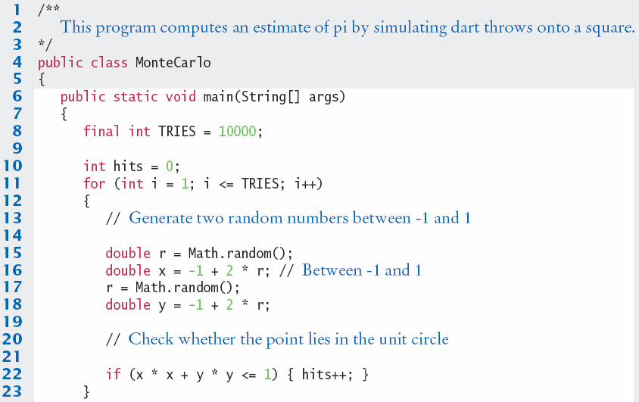
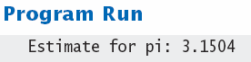
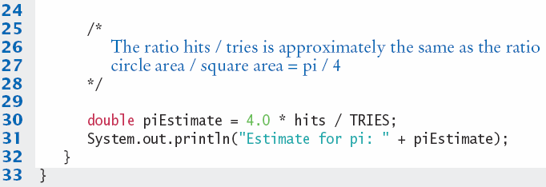
MonteCarlo.java

Slide 65
The ‘empty’ body
You probably have developed the habit of typing a semicolon at the end of each line
Don’t do this with loop statements!
The loop body becomes very short!
Between the closing ) and ;
What type of loop do I have now?
while (bal < TARGET);
{
year++;
interest = bal * RATE;
bal = bal + interest;
}

Slide 66
Drawing Graphical Shapes

Slide 67
Drawing Graphical Shapes

Slide 68
TwoRowsOfSquares.java

Slide 69
Summary: Types of Loops
There are three types of loops:
while Loops
for Loops
do Loops
Each loop requires the following steps:
Initialization (setup variables to start looping)
Condition (test if we should execute loop body)
Update (change something each time through)

Slide 70
Summary
A loop executes instructions repeatedly while a condition is true.
An off-by-one error is a common error when programming loops.
Think through simple test cases to avoid this type of error.
The for loop is used when a value runs from a starting point to an ending point with a constant increment or decrement.
The do loop is appropriate when the loop body must be executed at least once.

Slide 71
Summary
A sentinel value denotes the end of a data set, but it is not part of the data.
You can use a boolean variable to control a loop.
Set the variable to true before entering the loop, then set it to false to leave the loop.
When the body of a loop contains another loop, the loops are nested.
A typical use of nested loops is printing a table with rows and columns.
In a simulation, you use the computer to simulate an activity.
You can introduce randomness by calling the random number generator.

